Slide 1
MISSION 1 Advanced Software Developers
DANIEL NGUYEN

Slide 2

PROJECT!
Re-design the motor vehicle insurance purchasing experience.

Slide 3
1.
Stakeholder
Identify stakeholder for the project

Slide 4
Stakeholder
After-sales support staffs
Shareholders
CTO, CFO
Lenders
The Press
Turner’s Developer
Customers / Society
IT Staffs
Suppliers

Slide 5
2.
Chatbots
Advanced Software Developer

Slide 6
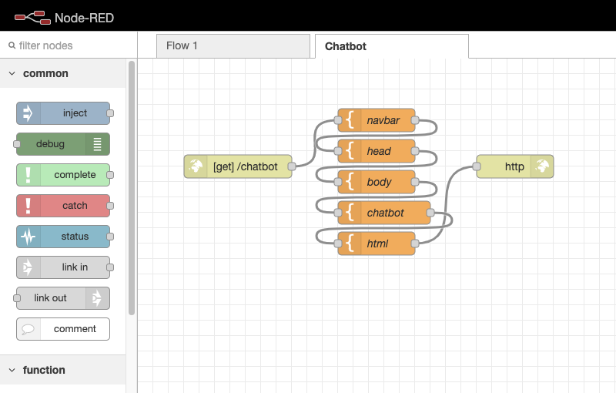
Technology
Node-Red
Watson Assistant
Bootstrap CSS/HTML
IBM Cloud Application
Place your screenshot here
Link
http://node-red-wcivf-2021-01-25.mybluemix.net/chatbot/

Slide 7

THANKS!
Any questions?
You can find me at:
danielm@
missionreadyhq.com

Slide 8
MISSION 2 Advanced Software Developers
DANIEL NGUYEN

Slide 9
Image Recognition Services
AWS – REKOGNITION
VS
IBM – VISUAL RECOGNITION
VS
AZURE – COMPUTER VISION

Slide 10
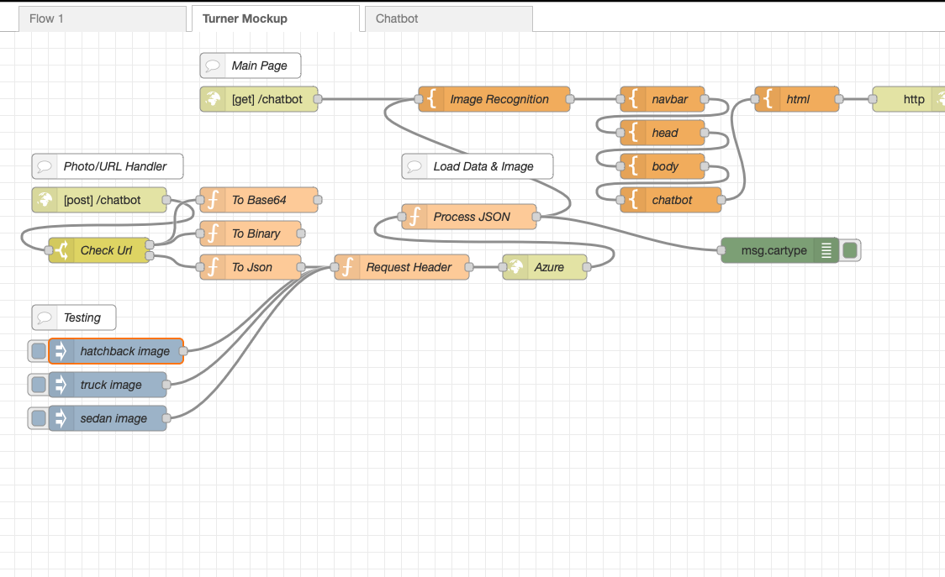
Technology
Node-Red
Watson Assistant
Bootstrap CSS/HTML
IBM Cloud Application
Azure – Computer Vision
Place your screenshot here
Link
http://node-red-wcivf-2021-01-25.mybluemix.net/chatbot/

Slide 11
API CALL
POST https://australiaeast.api.cognitive.microsoft.com/vision/v3.1/analyze?visualFeatures=Tags&language=en HTTP/1.1
Host: australiaeast.api.cognitive.microsoft.com
Content-Type: application/json
Ocp-Apim-Subscription-Key: ••••••••••••••••••••••••••••••••
{"url":"http://example.com/images/test.jpg"}
visualFeatures: Tags, Adult, Brands, Categories, Color,
Description, Faces, ImageType, Objects, Tags

Slide 12
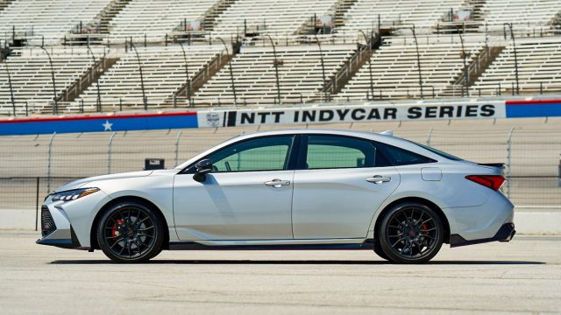
Azure Computer Vision
Name | Confidence Level
land vehicle | 0.9896427
wheel | 0.9884158
mid-size car | 0.7864713
sedan | 0.5848104
hatchback | 0.5169749

